Slide 1
Application Fundamentals
Gert Smith
Notes:
Application Fundamentals Introduction!

Slide 2
Building
Cross
Platform
Applications
Notes:
Introduce the Xamarin platform and how to architect a cross-platform application to maximize code re-use and deliver a high-quality native experience on all of the main mobile platforms: iOS, Android and Windows Phone.

Slide 3
Sharing Code Options
Best practices for developing mobile applications with Xamarin
Sharing Code Options
Shared Asset Projects - Use the Shared Asset Project type to organize your source code, and use #if compiler directives as required to manage platform-specific requirements.
Portable Class Libraries - Create a Portable Class Library (PCL) targeting the platforms you wish to support, and use Interfaces to provide platform-specific functionality.
Notes:
The two methods of sharing code between cross-platform projects: Shared Projects and Portable Class Libraries, including the benefits and disadvantages of each.

Slide 4
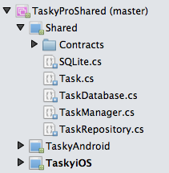
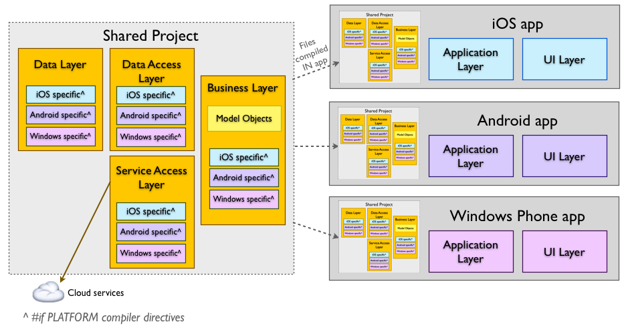
Shared Projects
Notes:
Shared Projects let you write common code that is referenced by a number of different application projects. The code is compiled as part of each referencing project and can include compiler directives to help incorporate platform-specific functionality into the shared code base.

Slide 5
Sharing Code Options - Shared Asset Projects
Benefits
Allows you to share code across multiple projects.
Shared code can be branched based on the platform using compiler directives (eg. using #if __ANDROID__ ,).
Application projects can include platform-specific references that the shared code can utilize (such as using Community.CsharpSqlite.WP7 in the Tasky sample for Windows Phone).
Disadvantages
Unlike most other project types, a Shared Project has no 'output' assembly. During compilation, the files are treated as part of the referencing project and compiled into that DLL.
Refactoring's that affect code inside 'inactive' compiler directives will not update the code.
Remarks
A good solution for application developers writing code that is only intended for sharing in their app (and not distributing to other developers).

Slide 6
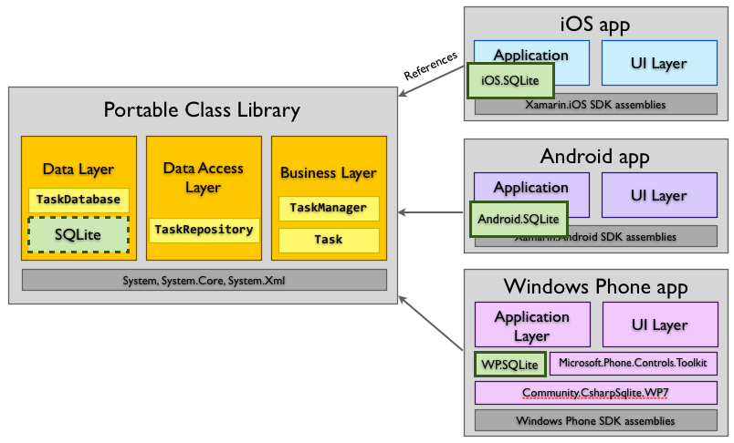
Portable Class Libraries
Notes:
Portable Class Libraries allow you to write code and produce libraries that can be shared across multiple platforms including Xamarin.iOS, Xamarin.Android and Windows Phone. Portable Class Libraries (PCLs) can be created in both Xamarin Studio and Visual Studio, and then referenced in each platform-specific project to allow code to be easily shared.

Slide 7
Sharing Code Options - Portable Class Libraries
Benefits
Allows you to share code across multiple projects.
Refactoring operations always update all affected references.
Disadvantages
Cannot use compiler directives.
Only a subset of the .NET framework is available to use, determined by the profile selected.
Remarks
A good solution if you plan to share the resulting assembly with other developers.

Slide 8
Xamarin is not just a "write-once, run everywhere” platform…
…because one of its strengths is the ability to implement native user interfaces specifically for each platform. However, with thoughtful design it’s still possible to share most of the non-user interface code and get the best of both worlds.
Write your data storage and business logic code once, and present native UIs on each platform.

Slide 9
Key points for creating Xamarin cross-platform apps
Use C# Write your apps in C#. Existing code written in C# can be ported to iOS and Android using Xamarin very easily, and obviously used on Windows Phone.
Utilize the MVC design pattern Develop your application’s User Interface using the Model/View/Controller or a Model/View/ViewModel approach where there is a clear separation between the "Model” and the rest. Split your application into two components: "Core” and "User-Interface”.
Build native Uis Each OS-specific application provides a different user-interface layer (implemented in C# with the assistance of native UI design tools)
Notes:
On iOS, use the MonoTouch.UIKit APIs utilizing Xamarin's iOS designer to create your UI visually.
On Android, use Android.Views taking advantage of Xamarin’s UI designer
On Windows Phone use XAML/Silverlight presentation layer, Visual Studio or Blend’s UI designer
On Windows 8, use the Metro APIs to create a native user experience.

Slide 10
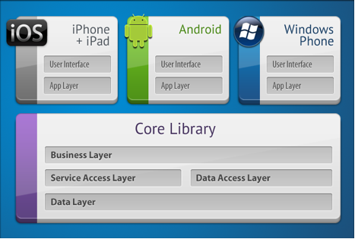
Separate Reusable Code into a Core Library
Notes:
By following the principle of separation of responsibility by layering your application architecture and then moving core functionality that is platform agnostic into a reusable core library, you can maximize code sharing across platforms

Slide 11
Understanding the Xamarin Mobile Platform
C# language – Allows you to use a familiar syntax and sophisticated features like Generics, Linq and the Parallel Task Library.
Mono .NET framework – Provides a cross-platform implementation of the extensive features in Microsoft’s .NET framework.
Compiler – Depending on the platform, produces a native app (eg. iOS) or an integrated .NET application and runtime (eg. Android). The compiler also performs many optimizations for mobile deployment such as linking away un-used code.
IDE tools – The Xamarin Studio IDE and the Xamarin plug-in for Visual Studio allow you to create, build and deploy Xamarin projects.
Notes:
The Xamarin platform consists of a number of elements that allow you to develop applications for iOS and Android:
In addition, because the underlying language is C# with the .NET framework, projects can be structured to share code that can also be deployed to Windows Phone.

Slide 12
Under the Hood
Compilation
iOS – C# is ahead-of-time (AOT) compiled to ARM assembly language. The .NET framework is included, with unused classes being stripped out during linking to reduce the application size. Apple does not allow runtime code generation on iOS, so some language features are not available.
Android – C# is compiled to IL and packaged with MonoVM + JIT’ing. Unused classes in the framework are stripped out during linking. The application runs side-by-side with Java/Dalvik and interacts with the native types via JNI.
Windows Phone – C# is compiled to IL and executed by the built-in runtime, and does not require Xamarin tools. Designing Windows Phone applications following Xamarin’s guidance makes it simpler to re-use the code on iOS and Android.
Notes:
Although Xamarin allows you to write apps in C#, and share the same code across multiple platforms, the actual implementation on each system is very different.
Runtime 'compilation' – generating code dynamically with System.Reflection.Emit – should be avoided. Apple’s kernel prevents dynamic code generation on iPhone and iPad, therefore emitting code on-the-fly will not work in Xamarin.iOS. Likewise, the Dynamic Language Runtime features cannot be used with Xamarin tools.
Some reflection features do work (eg. MonoTouch.Dialog uses it for the Reflection API), just not code generation.

Slide 13
Platform SDK Access
iOS – Xamarin.iOS exposes Apple’s CocoaTouch SDK frameworks as namespaces that you can reference from C#. For example the UIKit framework that contains all the user interface controls can be included with a simple using MonoTouch.UIKit; statement.
Android – Xamarin.Android exposes Google’s Android SDK as namespaces, so you can reference any part of the supported SDK with a using statement, such as using Android.Views; to access the user interface controls.
Windows Phone – Windows Phone is not part of the Xamarin platform. When building apps for Windows Phone in C#, the SDK is implicitly available to your application, including Silverlight/XAML controls for the user interface.
Notes:
Xamarin makes the features provided by the platform-specific SDK easily accessible with familiar C# syntax

Slide 14
Seamless Integration for Developers
The beauty of Xamarin is that despite the differences under the hood, Xamarin.iOS and Xamarin.Android (coupled with Microsoft’s Windows Phone SDK) offer a seamless experience for writing C# code that can be re-used across all three platforms.
Business logic, database usage, network access and other common functions can be written once and re-used on each platform, providing a foundation for platform-specific user interfaces that look and perform as native applications.

Slide 15
Integrated Development Environment (IDE) Availability
Development OS | Mac OS X | Windows
IDE | Xamarin Studio | Xamarin Studio | Visual Studio
iOS | Y | - | Y
Android | Y | Y | Y
Windows Phone | - | - | Y

Slide 16
Architecture
Encapsulation
Ensuring that classes and even architectural layers only expose a minimal API that performs their required functions, and hides the implementation details. At a class level, this means that objects behave as ‘black boxes’ and that consuming code does not need to know how they accomplish their tasks. At an architectural level, it means implementing patterns like Façade that encourage a simplified API that orchestrates more complex interactions on behalf of the code in more abstract layers. This means that the UI code (for example) should only be responsible for displaying screens and accepting user-input; and never interacting with the database directly. Similarly the data-access code should only read and write to the database, but never interact directly with buttons or labels.
Notes:
A key tenant of building cross-platform apps is to create an architecture that lends itself to a maximization of code sharing across platforms. Adhering to the following Object Oriented Programming principles helps build a well-architected application:

Slide 17
Architecture
Separation of Responsibilities
Ensure that each component (both at architectural and class level) has a clear and well-defined purpose. Each component should perform only its defined tasks and expose that functionality via an API that is accessible to the other classes that need to use it.
Notes:
A key tenant of building cross-platform apps is to create an architecture that lends itself to a maximization of code sharing across platforms. Adhering to the following Object Oriented Programming principles helps build a well-architected application:

Slide 18
Architecture
Polymorphism
Programming to an interface (or abstract class) that supports multiple implementations means that core code can be written and shared across platforms, while still interacting with platform-specific features.
Notes:
A key tenant of building cross-platform apps is to create an architecture that lends itself to a maximization of code sharing across platforms. Adhering to the following Object Oriented Programming principles helps build a well-architected application:

Slide 19
Handling Platform Divergence & Features
Fundamental elements that exist across platforms
Feature selection via tabs or menus
Lists of data and scrolling
Single views of data
Editing single views of data
Navigating back
Notes:
There are some characteristics of mobile applications that are universal. These are higher-level concepts that are generally true of all devices and can therefore form the basis of your application’s design:
When designing your high-level screen flow you can base a common user experience on these concepts.

Slide 20
Handling Platform Divergence & Features
Platform-specific attributes
Screen sizes – Some platforms (like iOS and Windows Phone) have standardized screen sizes that are relatively simple to target. Android devices have a large variety of screen dimensions, which require more effort to support in your application.
Navigation metaphors – Differ across platforms (eg. hardware ‘back’ button, Panorama UI control) and within platforms (Android 2 and 4, iPhone vs iPad).
Keyboards – Some Android devices have physical keyboards while others only have a software keyboard. Code that detects when a soft-keyboard is obscuring part of the screen needs to sensitive to these differences.
Notes:
In addition to the basic elements that exist on all platforms, you will need to address key platform differences in your design. You may need to consider (and write code specifically to handle) these differences:

Slide 21
Handling Platform Divergence & Features
Platform-specific attributes
Touch and gestures – Operating system support for gesture recognition varies, especially in older versions of each operating system. Earlier versions of Android have very limited support for touch operations, meaning that supporting older devices may require separate code
Push notifications – There are different capabilities/implementations on each platform (eg. Live Tiles in Windows Phone).
Notes:
In addition to the basic elements that exist on all platforms, you will need to address key platform differences in your design. You may need to consider (and write code specifically to handle) these differences:

Slide 22
Handling Platform Divergence & Features
Device-specific features
Camera – Functionality differs across devices: some devices don’t have a camera, others have both front- and rear-facing cameras. Some cameras are capable of video recording.
Geo-location & maps – Support for GPS or Wi-Fi location is not present on all devices. Apps also need to cater for the varying levels of accuracy that’s supported by each method.
Accelerometer, gyroscope and compass – These features are often found in only a selection of devices on each platform, so apps almost always need to provide a fallback when the hardware isn’t supported.
Notes:
Determine what the minimum features required for the application must be; or when decide what additional features to take advantage of on each platform. Code will be required to detect features and disable functionality or offer alternatives (eg. an alternative to geo-location could be to let the user type a location or choose from a map):

Slide 23
Handling Platform Divergence & Features
Device-specific features
Twitter and Facebook – only ‘built-in’ on iOS5 and iOS6 respectively. On earlier versions and other platforms you will need to provide your own authentication functions and interface directly with each services’ API.
Near Field Communications (NFC) – Only on (some) Android & iOS phones
Notes:
Determine what the minimum features required for the application must be; or when decide what additional features to take advantage of on each platform. Code will be required to detect features and disable functionality or offer alternatives (eg. an alternative to geo-location could be to let the user type a location or choose from a map):

Slide 24
Handling Platform Divergence & Features
Platform Abstraction
Business Façade pattern, provides a unified access across platforms and abstracts the particular platform implementations into a single, unified API.
Divergent Implementation
Invocation of specific platform features via divergent implementations via architectural tools such as interfaces and inheritance or conditional compilation.
Notes:
There are two different approaches to supporting multiple platforms from the same code-base, each with its own set of benefits and disadvantages.

Slide 25
Handling Platform Divergence & Features
Interfaces
Using interfaces allows you to implement platform-specific classes that can still be passed into your shared libraries to take advantage of common code.
Inheritance
The shared code could implement abstract or virtual classes that could be extended in one or more platform-specific projects. This is similar to using interfaces but with some behaviour already implemented. There are different viewpoints on whether interfaces or inheritance are a better design choice: in particular because C# only allows single inheritance it can dictate the way your APIs can be designed going forward. Use inheritance with caution.
Notes:
Using either interfaces or base classes defined in the shared code and implemented or extended in platform-specific projects. Writing and extending shared code with class abstractions is particularly suited to Portable Class Libraries because they have a limited subset of the framework available to them and cannot contain compiler directives to support platform-specific code branches.

Slide 26
Handling Platform Divergence & Features
Conditional Compilation
Conditional compilation works best with Shared Asset Projects, where the same source file is being referenced in multiple projects that have different symbols defined.
Xamarin projects always define MOBILE which is true for both iOS and Android application projects.
#if __MOBILE__
// Xamarin iOS or Android-specific code
#endif

Slide 27
Handling Platform Divergence & Features
iOS
Xamarin.iOS defines IOS which you can use to detect iOS devices
Android
Code that should only be compiled into Xamarin.Android applications can use the following
.
#if __IOS__
// IOS-specific code
#endif
#if __ANROID__
// Android-specific code
#endif
Notes:
Each API version also defines a new compiler directive, so code like this will let you add features if newer APIs are targeted. Each API level includes all the ‘lower’ level symbols. This feature is not really useful for supporting multiple platforms; #if __ANDROID_11__
Windows Phone 7 defines two symbols – WINDOWS_PHONE and SILVERLIGHT – that can be used to target code to the platform.

